Slide 1
Chapter 4 Ratio and Regression Estimation
Ratio and regression estimation use variables that are correlated with the variable of interest to improve the precision of estimators of the mean and total of a population.

Slide 2

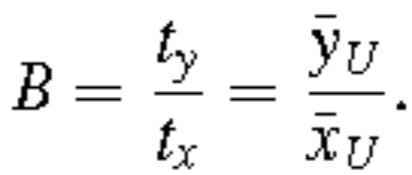
Ratio Estimation in a Simple Random Sample
For ratio estimation to apply, two quantities y_{i} and x_{i} must be measured on each sample unit; x_{i} is often called an auxiliary variable or subsidiary variable.
In the population of size N
and their ratio is
Condensed from Sampling Design and Analysis 2e by S. Lohr

Slide 3
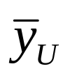
Ratio Estimation in a Simple Random Sample
In the simplest use of ratio estimation, a simple random sample (SRS) of size n is taken, and the information in both x and y is used to estimate B, t_{y}, or .
Ratio and regression estimation both take advantage of the correlation of x and y in the population; the higher the correlation, the better they work.
Condensed from Sampling Design and Analysis 2e by S. Lohr

Slide 4
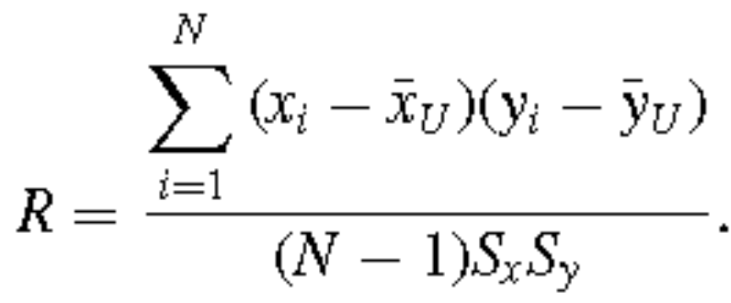
Ratio Estimation in a Simple Random Sample
Define the population correlation coefficient of x and y to be
Here, S_{x} is the population standard deviation of the x_{i}’s, S_{y} is the population standard deviation of the y_{i}’s, and R is simply the Pearson correlation coefficient of x and y for the N units in the population
Condensed from Sampling Design and Analysis 2e by S. Lohr

Slide 5
Ratio Estimation in a Simple Random Sample
E XA M P L E 4.1 Suppose the population consists of agricultural fields of different sizes. Let
y_{i} = palay production in field i
x_{i} = area of field i
Then
B = average yield in bushels per acre
= average yield in bushels per field
t_{y} = total yield in bushels.
Condensed from Sampling Design and Analysis 2e by S. Lohr

Slide 6
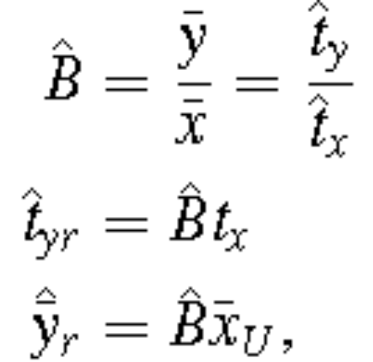

Ratio Estimation in a Simple Random Sample
If an SRS is taken, natural estimators for B, t_{y}, and are:
Condensed from Sampling Design and Analysis 2e by S. Lohr

Slide 7
Why Use Ratio Estimation?
1 Sometimes we simply want to estimate a ratio.
  In some survey situations, ratios of interest might be the ratio of liabilities to assets, the ratio of sales to advertising expenditure, or the per capita income of household members.
  Some ratio estimates appear disguised because the denominator looks like it is just a regular sample size.
  To determine whether you need to use ratio estimation for a quantity, ask yourself “If I took a different sample, would the denominator be a different number?” If yes, then you are using ratio estimation.
Condensed from Sampling Design and Analysis 2e by S. Lohr

Slide 8
Why Use Ratio Estimation?
2 Sometimes we want to estimate a population total, but the population size N is unknown.
3 Ratio estimation is often used to increase the precision of estimated means and totals.
4 Ratio estimation is used to adjust estimates from the sample so that they reflect demographic totals.
5 Ratio estimation may be used to adjust for nonresponse.
(Read discussion for each of these items.)
Condensed from Sampling Design and Analysis 2e by S. Lohr

Slide 9



Bias and Mean Squared Error of Ratio Estimators
Ratio estimators are usually biased for estimating the population mean and/or population total.
The estimation bias in ratio estimation arises because
is multiplied by .
The reduced variance of the ratio estimator usually compensates for the presence of bias – although
, the value of for any individual sample is likely to be closer to than is the sample mean .
Condensed from Sampling Design and Analysis 2e by S. Lohr

Slide 10
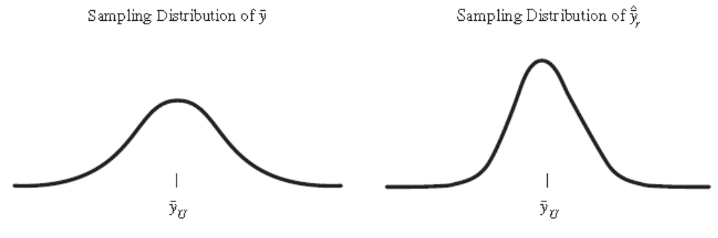
Bias and Mean Squared Error of Ratio Estimators
Condensed from Sampling Design and Analysis 2e by S. Lohr

Slide 11



Bias and Mean Squared Error of Ratio Estimators
After all, we take only one sample in practice; most people would prefer to be able to say that their particular estimate from the sample is likely to be close to the true value, rather than that their particular value of may be quite far from , but that the average deviation , averaged over all possible samples S that could be obtained, is zero.
For large samples, the sampling distributions of both and will be approximately normal.
Condensed from Sampling Design and Analysis 2e by S. Lohr

Slide 12

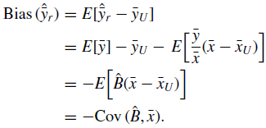
Bias and Mean Squared Error of Ratio Estimators
To calculate the bias of the ratio estimator of , note that
Since
Condensed from Sampling Design and Analysis 2e by S. Lohr

Slide 13

Bias and Mean Squared Error of Ratio Estimators
Consequently,
The absolute value of the bias of the ratio estimator is small relative to the standard deviation of the estimator if the coefficient of variation (CV) of .x is small.
For an SRS, , so that decreases as the sample size increases.
Condensed from Sampling Design and Analysis 2e by S. Lohr

Slide 14


Bias and Mean Squared Error of Ratio Estimators
The results just derived are exact, but not necessarily easy to use with data.
We now find approximations for the bias and variance of the ratio estimator that rely on the variances and covariance of
Consider
Condensed from Sampling Design and Analysis 2e by S. Lohr

Slide 15
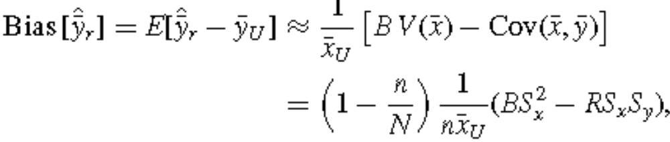
Bias and Mean Squared Error of Ratio Estimators
We can then show that
with R the correlation between x and y.
Condensed from Sampling Design and Analysis 2e by S. Lohr

Slide 16


Bias and Mean Squared Error of Ratio Estimators
The bias of is thus small if:
  the sample size n is large
  the sampling fraction n/N is large
  is large
  S_{x} is small
  the correlation R is close to 1.

Slide 17

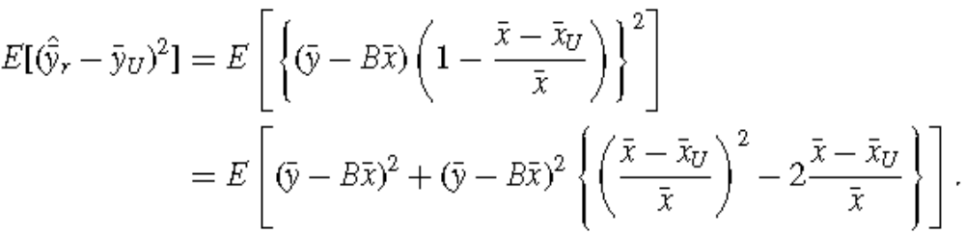
Bias and Mean Squared Error of Ratio Estimators
Note that if all x’s are the same value (Sx = 0), then the ratio estimator is the same as the SRS estimator and the bias is zero.
Estimating the MSE of

Slide 18
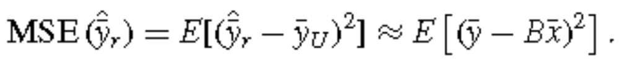
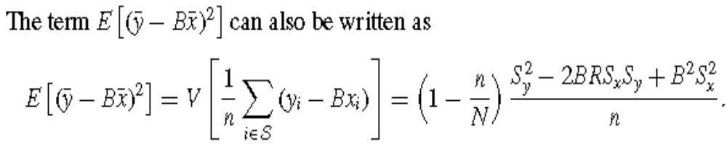
Bias and Mean Squared Error of Ratio Estimators
The second term is generally small compared with the first term, so the MSE is approximated by

Slide 19

Bias and Mean Squared Error of Ratio Estimators
Hence, the approximated MSE of will be small when
  the sample size n is large
  the sampling fraction n/N is large
  the deviations y_{i} − Bx_{i} are small
  the correlation R is close to +1.
In large samples, the bias of is typically small relative to V( ), so that MSE( ) ≈ V( )

Slide 20
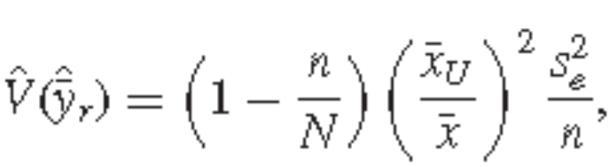
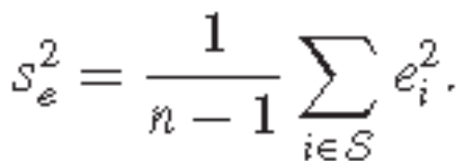
Bias and Mean Squared Error of Ratio Estimators
Define the new variable
e_{i} = y_{i} − x_{i},
which is the ith residual from fitting the line y = x.
We estimate the variance of the ratio estimator by
(4.9)
where s_{e}² is the sample variance of the residuals e_{i}

Slide 21

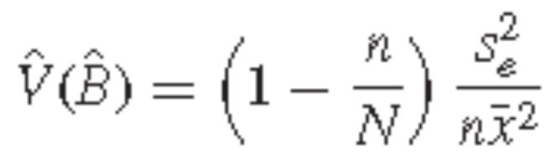

Bias and Mean Squared Error of Ratio Estimators
In large samples, we expect to be approximately equal to 1.
Similarly, (4.10)
and

Slide 22
Bias and Mean Squared Error of Ratio Estimators
If the sample sizes are sufficiently large, approximate 95% confidence intervals (CIs) can be constructed using the standard errors (SEs) as
See Example 4.4, page 127.

Slide 23
Ratio Estimation with Proportions
Ratio estimation works exactly the same way when the quantity of interest is a proportion.
See Example 4.5, page 129.
Condensed from Sampling Design and Analysis 2e by S. Lohr

Slide 24
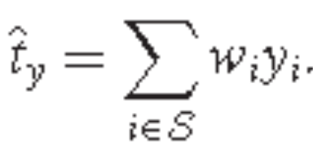
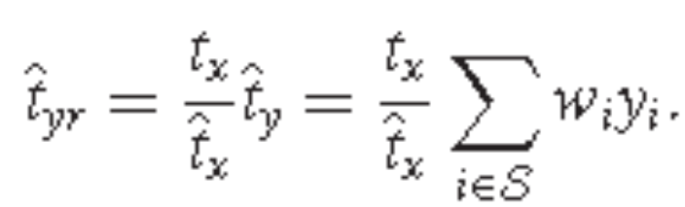
Ratio Estimation UsingWeight Adjustments
Recall: we wrote the estimated population total as a function of the observations y_{i} and weights w_{i} = 1/π_{i}:
Note that
We can think of the modification used in ratio estimation as an adjustment to each weight.

Slide 25



Ratio Estimation UsingWeight Adjustments
Define
so that
The estimator is a weighted sum of the observations, with weights w_{i}∗ = w_{i}g_{i}.
Unlike the original weights w_{i}, however, the adjusted weights w_{i}∗ depend upon values from the sample: If a different sample is taken, the weight adjustment g_{i} = will be different.

Slide 26
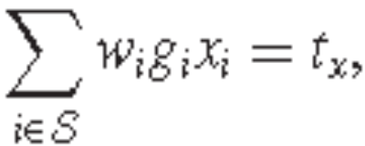
Ratio Estimation UsingWeight Adjustments
The weight adjustments g_{i} calibrate the estimates on the x variable.
Since the adjusted weights force the
estimated total for the x variable to equal the known population total t_{x}.
The factors g_{i} are called the calibration factors.

Slide 27
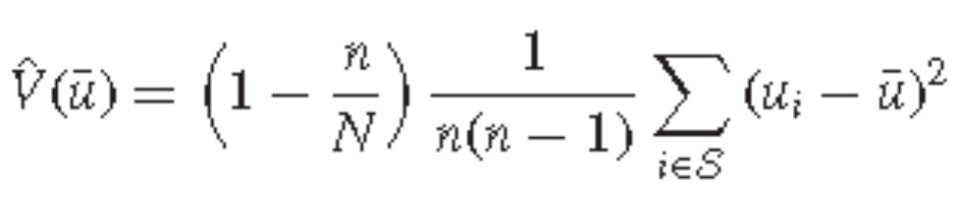
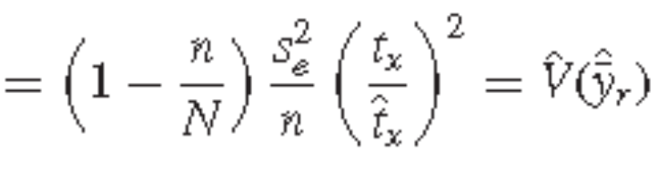
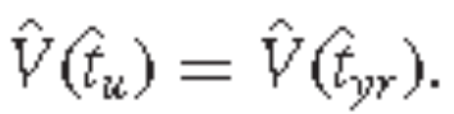
Ratio Estimation UsingWeight Adjustments
The variance estimators in (4.9) can be calculated by forming the new variable u_{i} = g_{i}e_{i}.
Then, for an SRS,
and, similarly,

Slide 28

Advantages of Ratio Estimation
Ratio estimation is motivated by the desire to use information about a known auxiliary quantity x to obtain a more accurate estimator of t_{y} or .
If x and y are perfectly correlated, that is, y_{i} = Bx_{i} for all i = 1, . . . , N, then = t_{y} and there is no estimation error.
In general, if y_{i} is roughly proportional to x_{i}, the MSE will be small.

Slide 29
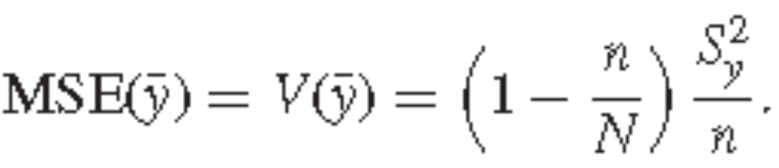
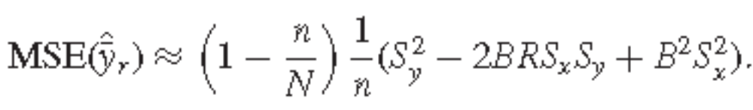
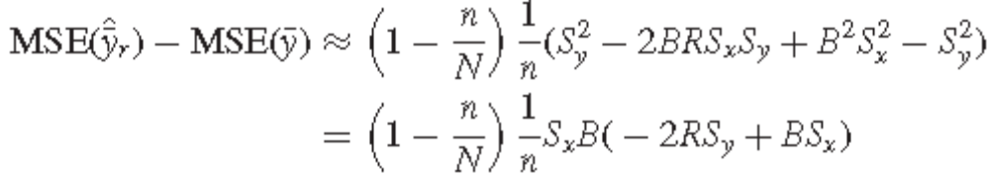
Advantages of Ratio Estimation
Recall
and
Hence,

Slide 30
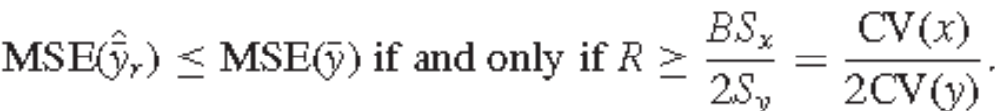
Advantages of Ratio Estimation
If the CVs are approximately equal, then it pays to use ratio estimation when the correlation between x and y is larger than 1/2.

Slide 31

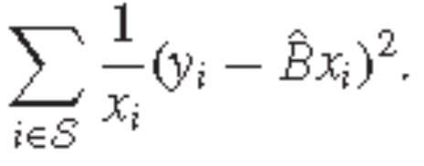
Advantages of Ratio Estimation
Ratio estimation is most appropriate if a straight line through the origin summarizes the relationship between x_{i} and y_{i} and if the variance of y_{i} about the line is proportional to x_{i}.
Under these conditions, is the weighted least squares regression slope for the line through the origin with weights proportional to 1/x_{i} - the slope
minimizes the sum of squares

Slide 32
Estimation in Domains
Often we want separate estimates for subpopulations; the subpopulations are called domains or subdomains.
We may want to take an SRS of 1000 people from a population of 50,000 people and estimate the average salary for men and the average salary for women.
There are two domains: men and women.
We do not know which persons in the population belong to which domain until they are sampled, though.

Slide 33
Estimation in Domains
Thus, the number of persons in an SRS who fall into each domain is a random variable, with value unknown at the time the survey is designed.
Estimating domain means is a special case of ratio estimation.
Suppose there are D domains.
Let U_{d} be the index set of the units in the population that are in domain d, and let S_{d} be the index set of the units in the sample that are in domain d, for d = 1, 2, . . . , D.

Slide 34

Estimation in Domains
Let N_{d} be the number of population units in U_{d} , and n_{d} be the number of sample units in S_{d}.
Suppose we want to estimate the mean salary for the domain of women,

Slide 35


Estimation in Domains
A natural estimator of is
which looks at first just like the sample mean.
The quantity n_{d} is a random variable, however: If a different SRS is taken, we will very likely have a different value for n_{d}, the number of women in the sample.

Slide 36

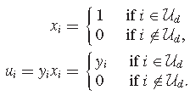
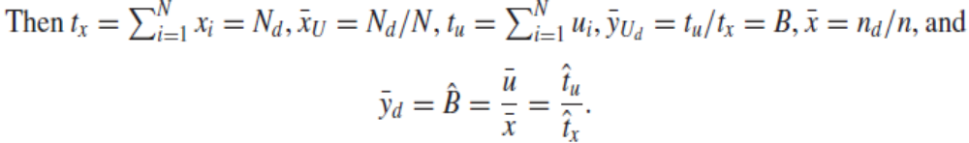
Estimation in Domains
To see that uses ratio estimation, let

Slide 37
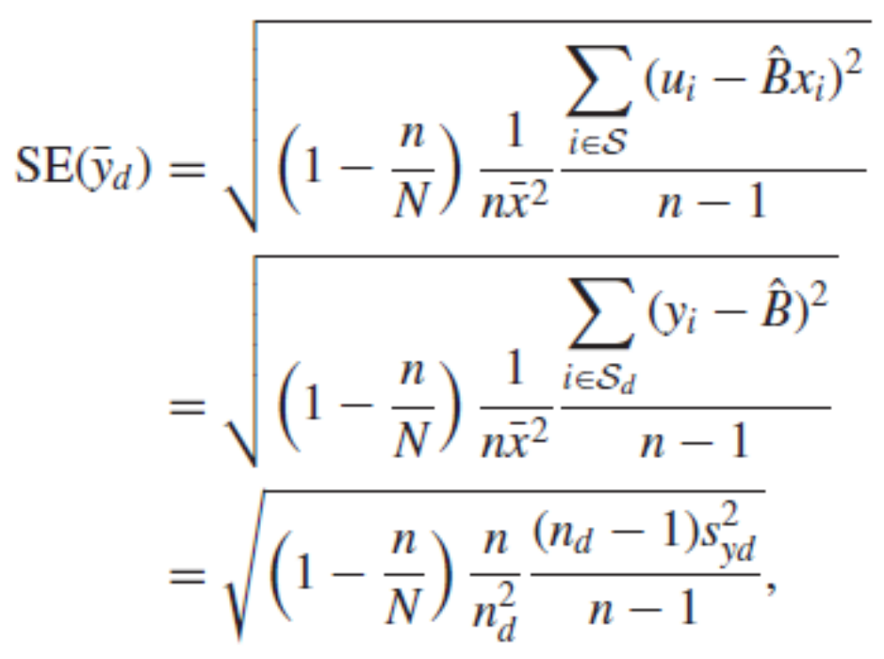
Estimation in Domains
Because we are estimating a ratio, we use (4.10) to calculate the standard error:

Slide 38
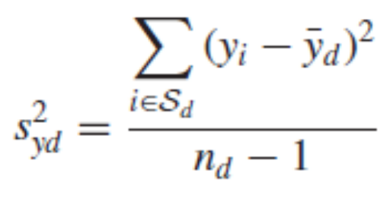
Estimation in Domains
where
is the sample variance of the sample observations in domain d.
Condensed from Sampling Design and Analysis 2e by S. Lohr

Slide 39
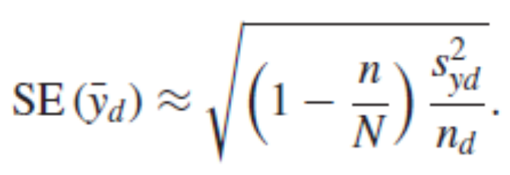
Estimation in Domains
If E(n_{d} ) is large, then (n_{d} − 1)/n_{d} ≈ 1 and
Condensed from Sampling Design and Analysis 2e by S. Lohr

Slide 40


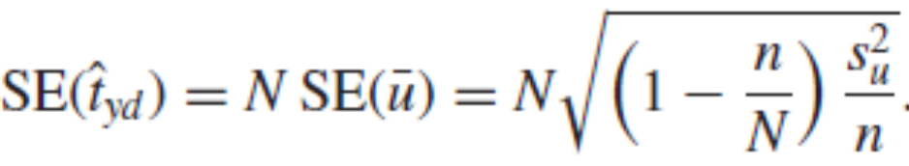
Estimation in Domains
The situation is a little more complicated when estimating a domain total.
If N_{d} is known, we can estimate t_{u} by
If N_{d} is unknown, though, we need to estimate t_{u} by
The standard error is
Read Example 4.8, page 136.
Condensed from Sampling Design and Analysis 2e by S. Lohr

Slide 41

Estimation in Domains
Summary:
  Estimating domain means is a special case of ratio estimation because the sample size in the domain varies from sample to sample.
  If the sample size for the domain in an SRS is sufficiently large, we can use SRS formulas for inference about the domain mean.
  Inference about totals depends on whether the population size of the domain, Nd , is known.
  If Nd is known, then the estimated total is
Condensed from Sampling Design and Analysis 2e by S. Lohr

Slide 42

Estimation in Domains
If N_{d} is unknown, then define a new variable u_{i} that equals y_{i} for observations in the domain and 0 for observations not in the domain; then use to estimate the domain total.
Condensed from Sampling Design and Analysis 2e by S. Lohr

Slide 43
Regression Estimation in Simple Random Sampling
Condensed from Sampling Design and Analysis 2e by S. Lohr

Slide 44
Using a Straight-Line Model
Ratio estimation works best if the data are well fit by a straight line through the origin.
Sometimes, data appear to be evenly scattered about a straight line that does not go through the origin—that is, the data look as though the usual straight-line regression model
y = B₀ + B₁x
would provide a good fit.
Condensed from Sampling Design and Analysis 2e by S. Lohr

Slide 45


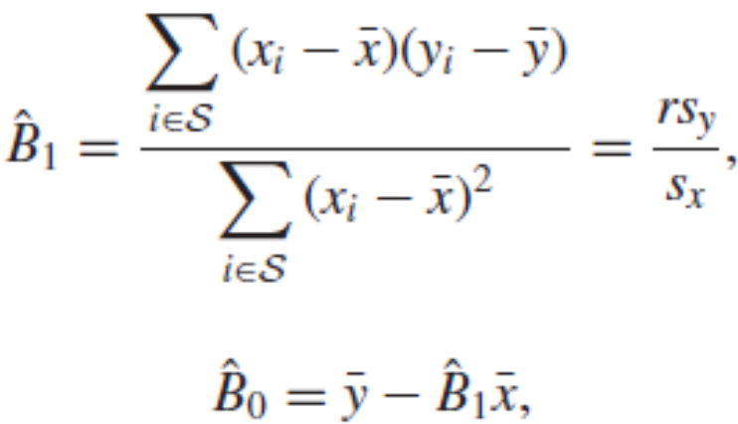
Using a Straight-Line Model
Let and be the ordinary least squares regression coefficients of the slope and intercept.
For the straight line regression model,
and r is the sample correlation coefficient of x and y.
Condensed from Sampling Design and Analysis 2e by S. Lohr

Slide 46



Using a Straight-Line Model
In regression estimation, like ratio estimation, we use the correlation between x and y to obtain an estimator for with (we hope) increased precision.
Suppose we know , the population mean for the x’s.
Then the regression estimator of is the predicted value of y from the fitted regression equation when x = :
(4.15)
Condensed from Sampling Design and Analysis 2e by S. Lohr

Slide 47





Using a Straight-Line Model
If from the sample is smaller than the population mean and x and y are positively correlated, then we would expect to also be smaller than .
The regression estimator adjusts by the quantity
Like the ratio estimator, the regression estimator is biased.
Condensed from Sampling Design and Analysis 2e by S. Lohr

Slide 48
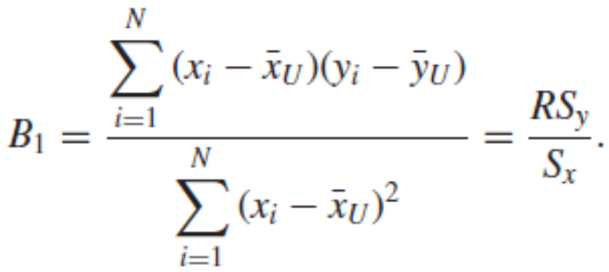

Using a Straight-Line Model
Let B₁ be the least squares regression slope calculated from all the data in the population,
Then, using (4.15), the bias of is given by .
Condensed from Sampling Design and Analysis 2e by S. Lohr

Slide 49


Using a Straight-Line Model
If the regression line goes through all of the points (x_{i}, y_{i}) in the population, then the bias is zero: in that situation, = B₁ for every sample, so Cov( , ) = 0.
As with ratio estimation, for large SRSs the MSE for regression estimation is approximately equal to the variance; the bias is often negligible in large samples.
Condensed from Sampling Design and Analysis 2e by S. Lohr

Slide 50

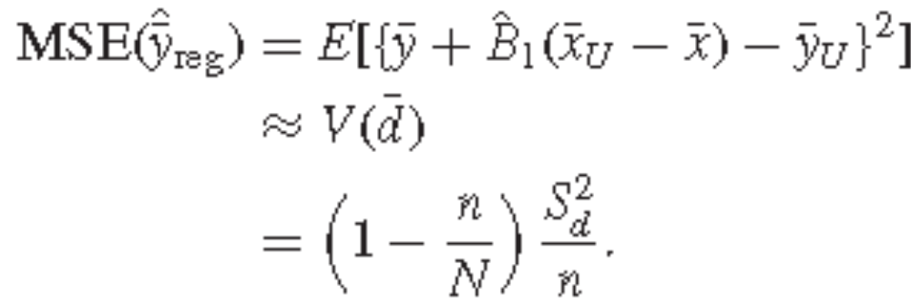
Using a Straight-Line Model
The method used in approximating the MSE in ratio estimation can also be applied to regression estimation.
Let
Then,
(4.17)
Condensed from Sampling Design and Analysis 2e by S. Lohr

Slide 51
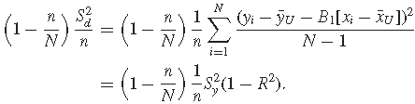
Using a Straight-Line Model
(4.18)
Thus, the approximate MSE is small when
  n is large
  n/N is large
S_{y} is small
The correlation R is close to −1 or +1.
Condensed from Sampling Design and Analysis 2e by S. Lohr

Slide 52

Using a Straight-Line Model
The standard error may be calculated by substituting estimates for the population quantities in (4.17) or (4.18).
To estimate S_{d}² using (4.17) : compute the residuals
so that and
Condensed from Sampling Design and Analysis 2e by S. Lohr

Slide 53
Using a Straight-Line Model
In small samples, we may alternatively calculate s_{e}² using the MSE from a regression analysis:
s_{e}² .
This adjusts the estimator for the degrees of freedom in the regression.
Condensed from Sampling Design and Analysis 2e by S. Lohr

Slide 54
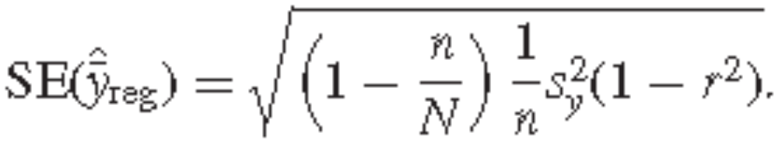
Using a Straight-Line Model
To estimate the variance using the formulation in (4.18):
  Substitute the sample variance s_{y}² and the sample correlation r for the population quantities S_{y}² and R, obtaining
Read Example 4.9, page 139.
Condensed from Sampling Design and Analysis 2e by S. Lohr

Slide 55
Difference Estimation
Difference estimation is a special case of regression estimation, used when the investigator “knows” that the slope B₁ is 1.
Difference estimation is often recommended in accounting when an SRS is taken.
Condensed from Sampling Design and Analysis 2e by S. Lohr

Slide 56
Difference Estimation
Example:
  A list of accounts receivable consists of the book value for each account—the company’s listing of how much is owed on each account.
  In the simplest sampling scheme, the auditor scrutinizes a random sample of the accounts to determine the audited value—the actual amount owed—in order to estimate the error in the total accounts receivable.
  The quantities considered are:
  y_{i} = audited value for company i
  x_{i} = book value for company i.
Condensed from Sampling Design and Analysis 2e by S. Lohr

Slide 57


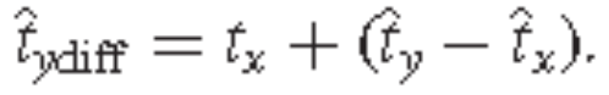


Difference Estimation
Example (cont’d)
  Then, is the mean difference for the audited accounts.
  The estimated total difference is ;
  The estimated audited value for accounts receivable is
  The residuals from this model are e_{i} = y_{i} − x_{i}.
  The variance of is
  where
Condensed from Sampling Design and Analysis 2e by S. Lohr

Slide 58
Difference Estimation
If the variability in the residuals e_{i} is smaller than the variability among the y_{i}, then difference estimation will increase precision.
Difference estimation works best if the population and sample have a large fraction of nonzero differences that are roughly equally divided between overstatements and understatements, and if the sample is large enough so that the sampling distribution of is approximately normal.
Condensed from Sampling Design and Analysis 2e by S. Lohr

Slide 59
Difference Estimation
In auditing, it is possible that most of the audited values in the sample are all the same as the corresponding book value.
In such a situation, the design-based variance estimator is unstable and a model-based approach may be preferred.
Condensed from Sampling Design and Analysis 2e by S. Lohr

Slide 60
Poststratification
Suppose a sampling frame lists all households in an area, and you would like to estimate the average amount spent on food in a month.
One desirable stratification variable might be household size because large households might be expected to have higher food bills than smaller households.
Condensed from Sampling Design and Analysis 2e by S. Lohr

Slide 61
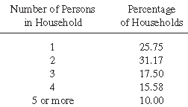
Poststratification
Suppose the distribution of household size in the region is known:
Condensed from Sampling Design and Analysis 2e by S. Lohr

Slide 62
Poststratification
The sampling frame, however, does not include information on household size - it only lists the households.
Thus, although you know the population size in each subgroup, you cannot take a stratified sample because you do not know the stratum membership of the units in your sampling frame.
You can, however, take an SRS and record the amount spent on food as well as the household size for each household in your sample.
If n, the size of the SRS, is large enough, then the sample is likely to resemble a stratified sample with proportional allocation: We would expect about 26% of the sample to be one-person households, about 31% to be two-person households, and so on.
Condensed from Sampling Design and Analysis 2e by S. Lohr

Slide 63

Poststratification
Considering the different household-size groups to be different domains, we can estimate the average amount spent on groceries for each domain.
Take an SRS of size n.
Let n₁, n₂, . . . , n_{H} be the numbers of units in the various household-size groups (domains) and let be the sample means for the groups.
In this case, since the poststrata are formed after the sample is taken, the sample domain sizes n₁, n₂, . . . , n_{H} are random quantities.
Condensed from Sampling Design and Analysis 2e by S. Lohr

Slide 64
Poststratification
If we selected another SRS from the population, the poststratum sizes in the sample would change.
Since the poststratum sizes in the population are known, however, we can use the known values of N_{h} in the estimation.
To see how poststratification fits in the framework of ratio estimation, define x_{ih} = 1 if observation i is in poststratum h and 0 otherwise.
Let u_{ih} = y_{i}x_{ih}.
Condensed from Sampling Design and Analysis 2e by S. Lohr

Slide 65
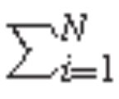
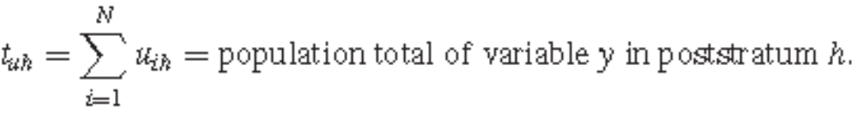
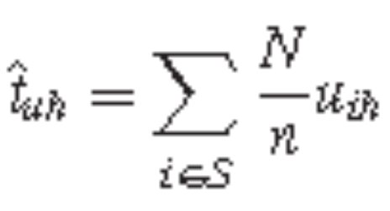
Poststratification
Then t_{xh} = x_{ih} = N_{h} and
For each poststratum h, we can estimate the total in the poststratum by
Condensed from Sampling Design and Analysis 2e by S. Lohr

Slide 66
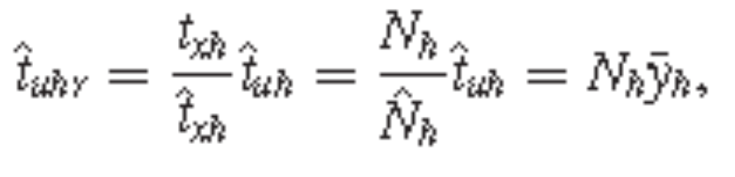
Poststratification
We can then use ratio estimation to obtain:
of the observations in poststratum h.
Condensed from Sampling Design and Analysis 2e by S. Lohr

Slide 67
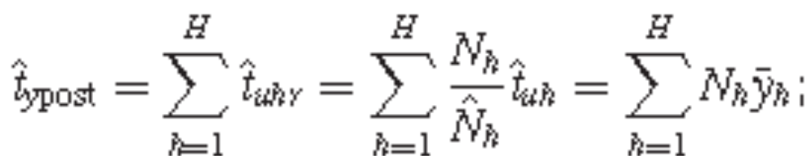
Poststratification
The poststratified estimator of the population total is
ratio estimation is used within each poststratum to estimate the population total in that poststratum.
Condensed from Sampling Design and Analysis 2e by S. Lohr

Slide 68
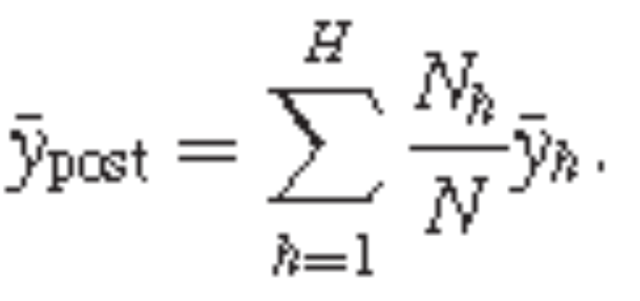
Poststratification
Condensed from Sampling Design and Analysis 2e by S. Lohr

Slide 69

Poststratification
If N_{h}/N is known, n_{h} is reasonably large (≥ 30 or so), and n is large, then we can use the variance for proportional allocation as an approximation to the poststratified variance:
This approximation is valid only when the expected sample sizes in each poststratum are large.
Condensed from Sampling Design and Analysis 2e by S. Lohr

Slide 70
Poststratification
Many large surveys use poststratification to improve efficiency of the estimators or to correct for the effects of differential nonresponse in the poststrata.
Condensed from Sampling Design and Analysis 2e by S. Lohr

Slide 71
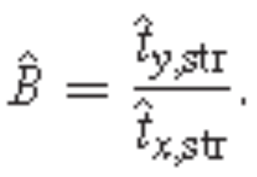
Ratio Estimation with Stratified Samples
The concept of ratio estimation is completely general and is easily extended to other sampling designs. In stratified sampling, for example, we can use estimators of the population totals for x and y from a stratified sample to give the combined ratio estimator
where
Condensed from Sampling Design and Analysis 2e by S. Lohr

Slide 72
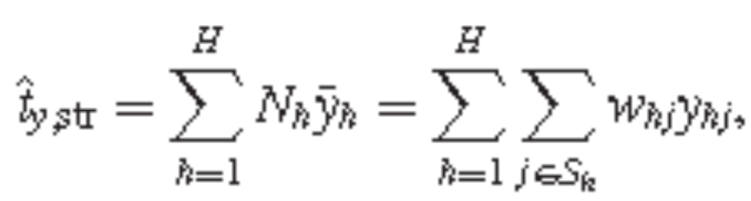
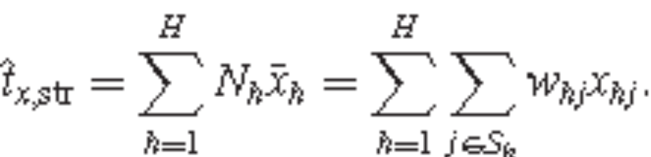
Ratio Estimation with Stratified Samples
Recall
Condensed from Sampling Design and Analysis 2e by S. Lohr

Slide 73
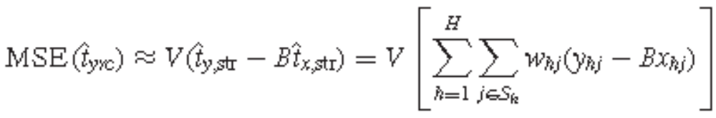
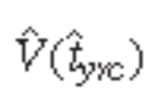
Ratio Estimation with Stratified Samples
Then, using the arguments similar to those in (),
we estimate the MSE by
Condensed from Sampling Design and Analysis 2e by S. Lohr

Slide 74
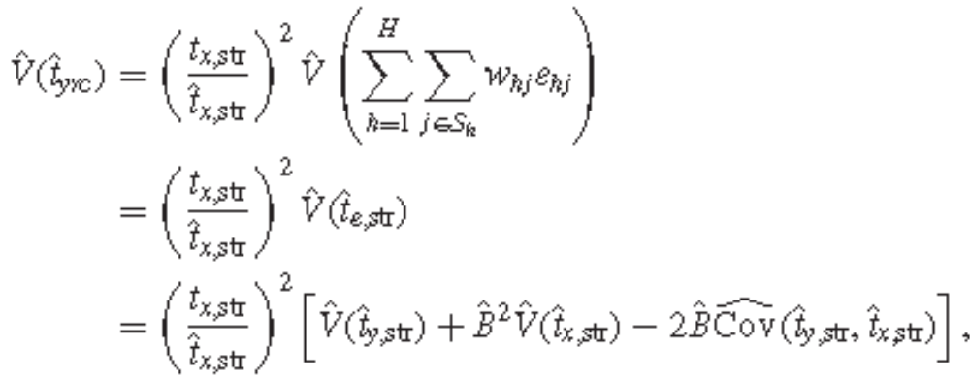
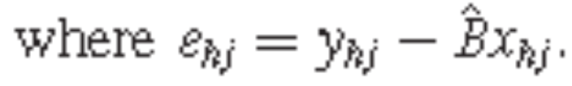
Ratio Estimation with Stratified Samples
Condensed from Sampling Design and Analysis 2e by S. Lohr

Slide 75


Ratio Estimation with Stratified Samples
In the combined ratio estimator, first the strata are combined to estimate t_{x} and t_{y}, then ratio estimation is applied.
For the separate ratio estimator, ratio estimation is applied first, then the strata are combined.
The estimator
uses ratio
estimation separately in each stratum, with
Condensed from Sampling Design and Analysis 2e by S. Lohr

Slide 76

Ratio Estimation with Stratified Samples
It can improve efficiency if the vary from stratum to stratum, but should not be used when strata sample sizes are small because each ratio is biased, and the bias can propagate through the strata.
Note that poststratification is a special case of the separate ratio estimator.
The combined estimator has less bias when the sample sizes in some of the strata are small.
Condensed from Sampling Design and Analysis 2e by S. Lohr

Slide 77
Ratio Estimation with Stratified Samples
When the ratios vary greatly from stratum to stratum, however, the combined estimator does not take advantage of the extra efficiency afforded by stratification as does the separate ratio estimator.
Read Example 4.10, page 145.
Condensed from Sampling Design and Analysis 2e by S. Lohr

Slide 78


Model-Based Theory for Ratio and Regression Estimation
In the design-based theory, the form of the estimators
were motivated by regression models.
Properties of the estimators, however, depend only on the sampling design.
Thus,
for an SRS.
Condensed from Sampling Design and Analysis 2e by S. Lohr

Slide 79
Model-Based Theory for Ratio and Regression Estimation
This variance approximation is derived from the simple random sampling formulas and does not rely on any assumptions about the model.
If the model does not fit the data well, ratio or regression estimation might not increase precision for estimated means and totals, but CIs for the means or totals will be correct in the sense that a 95% CI will have coverage probability close to 0.95.
Inferences about finite population quantities using ratio or regression estimation are correct even if the model does not fit the data well.
Condensed from Sampling Design and Analysis 2e by S. Lohr

Slide 80
Model-Based Theory for Ratio and Regression Estimation
For that reason, the ratio and regression estimators are examples of model-assisted estimators—a model motivates the form of the estimator, but inference depends on the sampling design.
Särndal et al. (1992) present the theory of model-assisted estimation, in which inference is based on randomization theory.
Condensed from Sampling Design and Analysis 2e by S. Lohr

Slide 81
Model-Based Theory for Ratio and Regression Estimation
Regression analysis makes assumptions about the regression model, find the least squares estimators of the regression parameters under the model, and plot residuals and explore regression diagnostics to check how well the model fits the data.
Such a model-based approach, pioneered by Brewer (1963) and Royall (1970), can also be followed with survey data.
As in the model-based approach, the model is used to predict population values that are not in the sample.
Condensed from Sampling Design and Analysis 2e by S. Lohr

Slide 82
A Model for Ratio Estimation
Recall: ratio estimation works well in an SRS when a straight line through the origin fits well and when the variance of the observations about the line is proportional to x.
We can state these conditions as a linear regression model: Assume that x₁, x₂, . . . , x_{N} are known (and all are greater than zero) and that Y₁, Y₂, . . . , Y_{N} are independent and follow the model
Y_{i} = βx_{i} + ε_{i}, (4.23)
where E_{M}(ε_{i}) = 0 and V_{M}(ε_{i}) = σ_{i}²x.
Condensed from Sampling Design and Analysis 2e by S. Lohr

Slide 83
A Model for Ratio Estimation
The independence of observations in the model is an explicit statement that the sampling design gives no information that can be used in estimating quantities of interest; the sampling procedure has no effect on the validity of the model.
Under the model, T_{y} = Σ Y_{i} is a random variable and the population total of interest, t_{y}, is one realization of the random variable T_{y} (this is in contrast to the randomization approach, in which t_{y} is considered to be a fixed but unknown quantity and the only random variables are the sample indicators Z_{i}).
Condensed from Sampling Design and Analysis 2e by S. Lohr

Slide 84



A Model for Ratio Estimation
If S represents the set of units in our sample, then
We observe the values of y_{i} for units in the sample, and predict those for units not in the sample as
where is the weighted least squares estimate of β under (4.23)
Condensed from Sampling Design and Analysis 2e by S. Lohr

Slide 85


A Model for Ratio Estimation
Then a natural estimator of t_{y} is
Note: the finite population ratio B = t_{y}/t_{x} is the weighted least squares estimator of β, applied to the entire population.
Condensed from Sampling Design and Analysis 2e by S. Lohr

Slide 86
A Model for Ratio Estimation
In many common sampling schemes, we find that if we adopt a model consistent with the reasons we would adopt a certain sampling scheme or method of estimation, the point estimators obtained using the model are very close to the design-based estimators.
The model-based variance, though, usually differs from the variance from the randomization theory.
Condensed from Sampling Design and Analysis 2e by S. Lohr

Slide 87
A Model for Ratio Estimation
In randomization theory, or design-based sampling, the sampling design determines how sampling variability is estimated.
In model-based sampling, the model determines how variability is estimated, and the sampling design is irrelevant—as long as the model holds, you could choose any n units you want to from the population.
Condensed from Sampling Design and Analysis 2e by S. Lohr

Slide 88


A Model for Ratio Estimation
The model-based estimator
is unbiased under the assumed model in (4.23) since
Condensed from Sampling Design and Analysis 2e by S. Lohr

Slide 89



A Model for Ratio Estimation
The model-based variance is
because and are independent under the model assumptions
Condensed from Sampling Design and Analysis 2e by S. Lohr

Slide 90


A Model for Ratio Estimation
The model (4.23) does not depend on which population units are selected to be the sample S, so S can be treated as though it is fixed.
Consequently,
Condensed from Sampling Design and Analysis 2e by S. Lohr

Slide 91


A Model for Ratio Estimation
and, similarly,
Condensed from Sampling Design and Analysis 2e by S. Lohr

Slide 92



A Model for Ratio Estimation
Combining the two terms,
Condensed from Sampling Design and Analysis 2e by S. Lohr

Slide 93


A Model for Ratio Estimation
Note that if the sample size is small relative to the population size, then
the quantity (1 − ) serves as an fpc in the model-based approach to ratio estimation.
Condensed from Sampling Design and Analysis 2e by S. Lohr

Slide 94
A Model for Ratio Estimation
When adopting a model for a set of data, we need to check the assumptions of the model;
  1 The model is correct, that is, E_{M}(Y_{i}) = x_{i}β.
  2 The variance structure is correct, that is, V_{M}(Y_{i}) = σ²x_{i}.
  3 The observations are independent.
Typically, assumptions 1 and 2 are checked by plotting the data and examining residuals from the model.
Assumption 3, however, is difficult to check in practice, and requires knowledge of how the data were collected.
Condensed from Sampling Design and Analysis 2e by S. Lohr

Slide 95

A Model for Ratio Estimation
Generally, if you take a random sample, then you may assume the observations are independent.
We can perform some checks on the appropriateness of a model with straight line through the origin for these data: If the variance of y_{i} about the line is proportional to x_{i}, then a plot of the weighted residuals.
against x_{i} or log x_{i} should not exhibit any patterns.
Condensed from Sampling Design and Analysis 2e by S. Lohr

Slide 96


A Model for Regression Estimation
A similar result occurs for regression estimation; for that, the model is Y_{i} = β₀ + β₁x_{i} + ε_{i},
where the εi are independent and identically distributed with mean 0 and constant variance σ².
The least squares estimators of β₀ and β₁ in this model are
and
Condensed from Sampling Design and Analysis 2e by S. Lohr

Slide 97

A Model for Regression Estimation
Then, using the predicted values in place of the units not sampled,
Condensed from Sampling Design and Analysis 2e by S. Lohr

Slide 98


A Model for Regression Estimation
The regression estimator of Ty is thus N× (predicted value under the model at ).
Condensed from Sampling Design and Analysis 2e by S. Lohr

Slide 99


A Model for Regression Estimation
In practice, if the sample size is small relative to the population size and we have an SRS, we can simply ignore the fpc and use the standard error for estimating the mean value of a response.
From regression theory, the variance of ( ) is
Condensed from Sampling Design and Analysis 2e by S. Lohr

Slide 100

A Model for Regression Estimation
Thus if n/N is small,
Condensed from Sampling Design and Analysis 2e by S. Lohr

Slide 101
Differences Between Model-Based and Design-Based Estimators
Under the ratio model, the point estimator for the population total is the same as in the design-based approach, but the variance differs from that for the design-based estimator.
Why aren’t the standard errors the same as in randomization theory?
That is, how can we have two different variances for the same estimator?
Condensed from Sampling Design and Analysis 2e by S. Lohr

Slide 102
Differences Between Model-Based and Design-Based Estimators
The discrepancy is due to the different definitions of variance:
In design-based sampling, the variance is the average squared deviation of the estimate from its expected value, averaged over all samples that could be obtained using a given design.

Slide 103
Differences Between Model-Based and Design-Based Estimators
If we are using a model, the variance is again the average squared deviation of the estimate from its expected value, but here the average is over all possible samples that could be generated from the population model.
The model-based estimator uses a prediction approach, in which the values of y_{i} not in the sample are predicted using the model.
Condensed from Sampling Design and Analysis 2e by S. Lohr

Slide 104

Differences Between Model-Based and Design-Based Estimators
We have
If you were absolutely certain that your model was correct, you could minimize the model-based variance of the regression estimator by including only the members of the population with the largest and smallest values of x to be in the sample, and excluding units with values of x between those extremes.
Condensed from Sampling Design and Analysis 2e by S. Lohr

Slide 105
Differences Between Model-Based and Design-Based Estimators
No one would recommend such a design in practice, of course, because one never has that much assurance in a model.
However, nothing in the model says that you should take an SRS or any other type of probability sample, or that the sample needs to be representative of the population—as long as the model is correct.
What if the model is wrong? The model-based estimates are only model-unbiased—that is, they are unbiased only within the structure of that particular model.
Condensed from Sampling Design and Analysis 2e by S. Lohr

Slide 106
Differences Between Model-Based and Design-Based Estimators
If the model is wrong, the model-based estimators will be biased, but, from within the model, we will not necessarily be able to tell how big the bias is.
Thus, if the model is wrong, the model-based estimator of the variance generally underestimates the MSE.
When using model-based inference in sampling, then, you need to be very careful to check the assumptions of the model by examining residuals and using other diagnostic tools.
Condensed from Sampling Design and Analysis 2e by S. Lohr

Slide 107
Differences Between Model-Based and Design-Based Estimators
The assumption of independence is typically the most difficult to check.
One can (and should!) perform diagnostics to check some of the assumptions of the model for the sampled data, but need to realize that you are making a strong, untestable assumption that the model applies to population units you did not observe.
Condensed from Sampling Design and Analysis 2e by S. Lohr

Slide 108
Differences Between Model-Based and Design-Based Estimators
The randomization-based estimator of the MSE may be used whether any given model fits the data or not, because randomization inference depends only on how the sample was selected.
But even the most die-hard randomization theorist relies on models for nonresponse, and for designing the survey.
Hansen et al. (1983) point out that generally randomization theory samplers have a model in mind when designing the survey and take that model into account to improve efficiency.
Condensed from Sampling Design and Analysis 2e by S. Lohr

Slide 109
End of Chapter 4
Make sure to read the Chapter Summary.

